Slide 1
Kliederkerk - all ages
from thinking in age toward thinking in talents
Nelleke Plomp - coördinator of kliederkerk in the Netherlands

Slide 2
Write down for yourself:
What things or activities in your life are ‘ageless’?
What things in life do you do with people of different generations together?

Slide 3
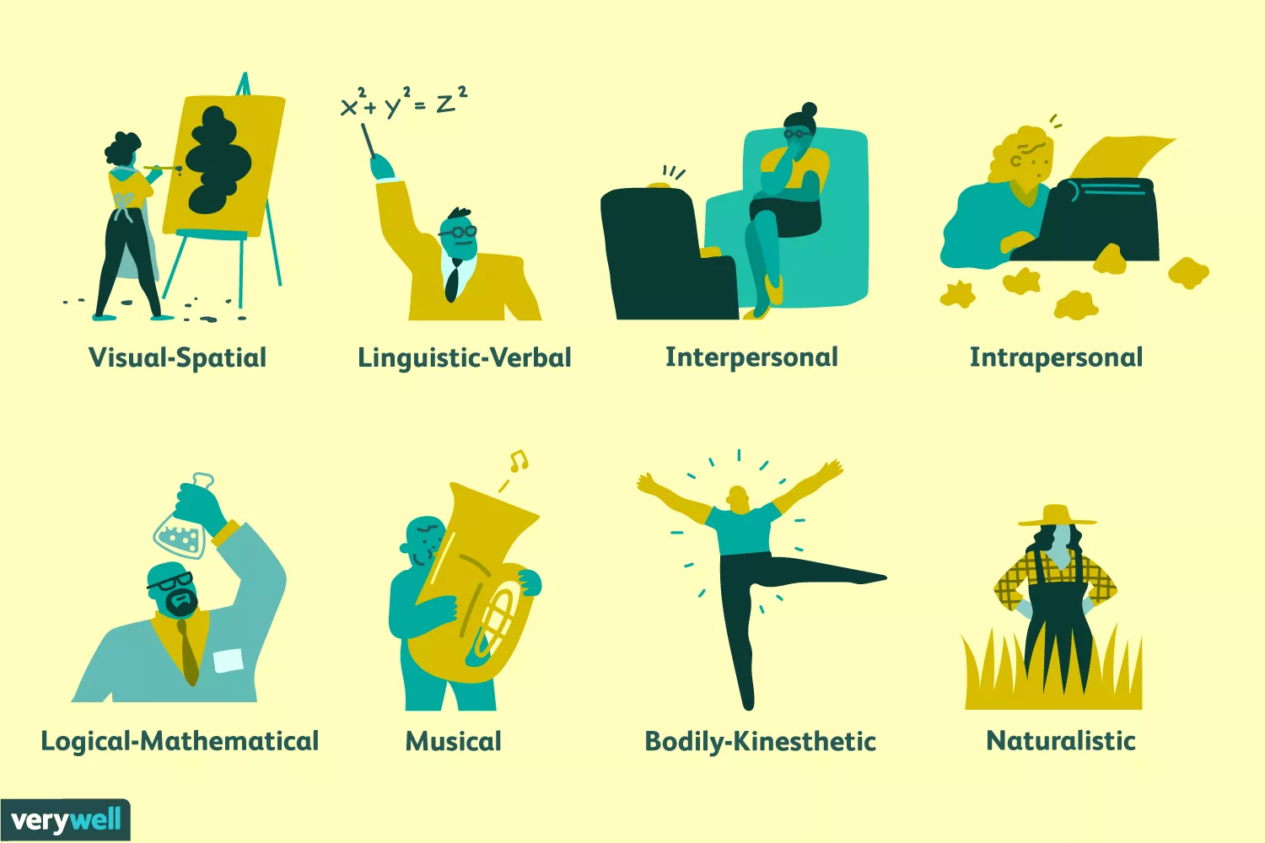
Multiple intelligences
Howard Gardner

Slide 4
Write one thing down to take home to your context:
Which place or activity in your community can you re-think as ageless?

